Slide 1
Professional Services: The Risk Landscape
Presented by Gareth Milner of JMG Group for The RiskBites ® Club​​
8 September 2026

Slide 2


Professional Services: The Risk Landscape

Slide 3

Professional Services: The Risk Landscape
Gareth & JMG
22 years’ experience placing insurances for law firms and other ‘white collar’ services
A national team acting for 620 professional services clients
£22M of premium placed into the market for professional services
Top 20 UK broker placing £500M+ of premium in total
Established, very active acquirer of specialist UK broking businesses
Our challenges are the same as yours

Slide 4
Professional Services: The Risk Landscape
Definitions of risk
1. Cambridge English Dictionary
The possibility of something bad happening
2. An insured firm
The chance of something happening that will adversely affect the firm’s business
3. An insurer
The chance of something happening that will adversely affect the firm’s business and / or the insurer’s profitability

Slide 5
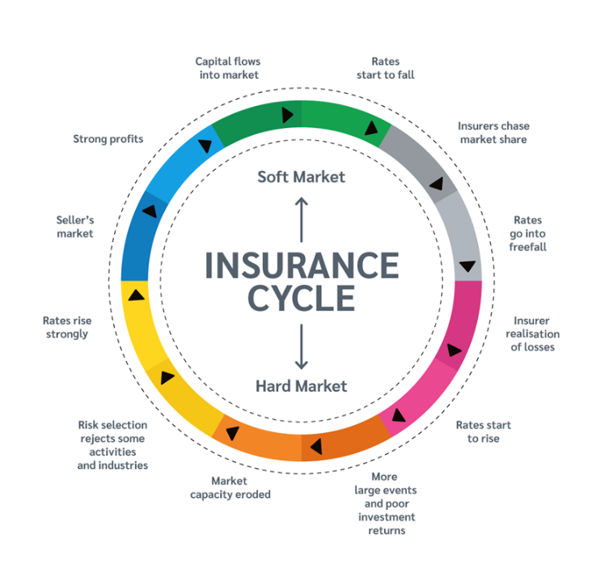
Professional Services: The Risk Landscape
Professional Indemnity Market Cycle

Slide 6

Professional Services: The Risk Landscape
Composites vs. Managing General Agents
Composite Insurer
An insurance company (usually a large financial institution and / or PLC) authorised to provide general insurance under a single corporate entity.
Managing General Agent
A specialist intermediary given formal power by insurer(s) to underwrite, price and issue policies on their behalf
The Difference…

Slide 7
Professional Services: The Risk Landscape
Claims
Missed deadlines / key dates / delays
Data & confidentiality breaches
Fraud (rogue Partner / fee earner)
Compliance failures
Acting ‘just’ outside of scope (e.g. law firms & tax advice)
Regulatory investigations & issues
Negligent advice rarely features!

Slide 8
Professional Services: The Risk Landscape
Key Risks
People & Succession Planning
Business models & client pricing pressure
Changing regulation
Cyber security
AI & Tech Disruption
M&A and Market Consolidation
Social Responsibility

Slide 9
Professional Services: The Risk Landscape
Thank You
Questions, thoughts & comments

Slide 10


Slide 11
Professional Services: The Risk Landscape
Presented by Gareth Milner of JMG Group for The RiskBites ® Club
​​
For more information contact: gareth.milner@jmginsurance.co.uk
Disclaimer
.
Please note that the information contained in this presentation is provided for general informational purposes only. It does not constitute any form of legal or other professional advice, and you should not use it as a substitute for advice tailored to your specific circumstances.
We disclaim all and any liability for any actions you take (or omit to take) in reliance upon the contents of this presentation.
Our contact details are below should you wish to contact us for professional advice.
Risk@kareneckstein.co.uk
07973627039

