Slide 1
AI, GDPR, IT and Supplier Risks: Where Things Go Wrong (and How to Fix Them)
Presented by Peter Wright Solicitor and Managing Director of Digital Law for The RiskBites ® Club​​
12 May 2026

Slide 2
Today:
Common Data Protection risks and how to mitigate these to comply with legal and regulatory obligations;
Common IT risks and actions to be considered;
Risks around the use of generative AI;
Supplier Contracts – common pitfalls and advice in relation to due diligence exercises;
Case studies from the ICO and lessons learned; and
Practical takeaways including, questions to ask your suppliers and an overview of key internal governance procedures, including AI governance.

Slide 3
Risk Landscape: Overview
Rapid AI Adoption – the increase of widespread AI use with limited appreciation for risk;
Evolving Data Protection Compliance Obligations – specifically around the use of AI;
Increased Cyber Threats;
Reliance on Complex Third-Party Agreements;
Expanded Use of Cloud-Based and AI-Based Vendors; and
Governance and Accountability Challenges.
Risk is increasingly interconnected. Effective mitigation requires a joined-up approach across AI, data protection, IT systems and supplier management.

Slide 4
Data Protection Risks
Non-compliance with core principles of Data Protection Act 2018, UK GDPR and the Data Use and Access Act (“DUAA”);
Unclear lawful basis for processing;
Inadequate transparency;
Data security weaknesses;
Data breaches and delayed reporting;
Poor data subject rights handling;
Unlawful international data transfers;
Lack of accountability and documentation;
Third-party supplier risks; and
Excessive data retention.

Slide 5
Data Protection: Risk Mitigation
Risk Area | Actions
Non-compliance with core principles under UK GDPR | Embed data protection principles into policies, training, and day-to-day processes.
Unclear lawful basis for processing | Identify and document a valid lawful basis for all processing activities.
Inadequate transparency | Maintain clear, accessible, and up-to-date privacy notices and policies.
Data security weaknesses | Implement appropriate technical and organisational security measures (e.g. access controls, encryption).
Data breaches and delayed reporting | Establish and test incident response plans; ensure timely reporting to the Information Commissioner's Office (“ICO”).
Poor handling of data subject rights | Put in place processes to manage and respond to requests within required timeframes.
Unlawful international data transfers | Use approved transfer mechanisms and carry out transfer risk assessments as appropriate.
Lack of accountability and documentation | Maintain records of processing, policies, and Data Protection Impact Assessments (“DPIAs”) where required.
Third-party/supplier risk | Conduct due diligence and ensure robust data processing agreements are in place.
Excessive data retention | Implement and enforce clear data retention and deletion policies.

Slide 6
IT Risks
Cyber Attacks;
Data Breaches;
Weak Access Controls;
Insider Threats;
Unpatched Systems/Updates;
Third-Party/Supply Chain Risks;
Regulatory Non-Compliance;
Physical Security Breaches;
Poor Incident Response Procedures; and
Lack of Staff Awareness.

Slide 7
IT Risk Mitigation
Risk | Mitigation Actions
Cyber attacks (phishing, malware, ransomware) | Staff awareness training, email filtering, endpoint protection (EDR/antivirus), multi-factor authentication (“MFA”), regular patching, network segmentation and appropriate incident response plans.
Data breaches (personal or sensitive data) | Data encryption (at rest & in transit), access controls, regular audits and compliance with UK GDPR.
Weak access controls / credential theft | Enforce strong password policies, MFA wherever possible, use of single sign-on (SSO) and regular access reviews.
Insider threats (malicious or accidental) | Role-based access control, monitoring/logging, user behaviour analytics, clear policies, staff training and joiner/mover/leaver processes.
Unpatched systems & software vulnerabilities | Automated patch management, vulnerability scanning and penetration testing.

Slide 8
IT Risk Mitigation
Risk | Mitigation Actions
Third-party / supply chain risks | Vendor due diligence, security requirements in contracts and ongoing supplier assessments.
Regulatory non-compliance (e.g. data protection, industry rules) | Regular audits, appoint a Data Protection Officer (“DPO”) (if required) and ensure that policies comply with the UK Data Protection Act 2018 and the Data Use and Access Act (“DUAA”).
Physical security breaches (device theft, office access) | Access controls (badges, CCTV), device encryption, secure disposal of hardware and clear desk policy.
Inadequate incident response capability | Documented incident response plan, defined roles, tabletop exercises and integration with National Cyber Security Centre incident guidance.
Lack of staff security awareness | Ongoing training, phishing simulations, clear reporting channels and security culture initiatives.

Slide 9
AI Risks
Bias and Discriminative AI Outputs;
Lack of Transparency;
Data Protection/Privacy Breaches;
Hallucinations and Inaccurate Outputs;
Over-reliance on AI;
Security Vulnerabilities;
Third-Party/Vendor Risks; and
Lack of AI Governance.

Slide 10
AI Risk Mitigation
Risk | Mitigation Actions
Bias and discrimination in AI outputs | Use diverse, representative training data, conduct bias testing and audits, implement fairness metrics and maintain human oversight.
Lack of transparency / explainability | Use explainability tools, document model logic and limitations and provide clear user disclosures.
Data protection & privacy breaches | Minimise personal data use, anonymise/pseudonymise datasets, implement strong access controls, carry out DPIAs and comply with UK GDPR and ICO recommendations.
Hallucinations / inaccurate outputs | Validate outputs against trusted sources, implement human overviews/review processes and define acceptable-use boundaries.
Over-reliance on AI (automation bias) | Train staff to critically assess AI outputs, require human approval for key decisions and clearly define where AI can/cannot be used.
Security vulnerabilities (model or API abuse) | Monitor usage and follow National Cyber Security Centre guidance.
Third-party / vendor risk (AI providers) | Perform due diligence, assess model training sources, ensure contractual safeguards and monitor provider performance and compliance.
Lack of governance and accountability | Create AI governance frameworks, maintain model documentation and complete regular audits.

Slide 11
Ensures compliance with UK laws such as UK GDPR and reduces legal risk.
Protects sensitive data by confirming adequate security and privacy controls.
Clarifies service levels, responsibilities, and performance expectations.
Identifies financial risks including hidden costs and unfavourable pricing terms.
Reduces dependency risks by addressing exit terms, vendor lock-in, and continuity plans.
Supplier Contracts: Importance

Slide 12
Supplier Contracts: Risks
Legal and regulatory breaches – risk of non-compliance with UK requirements such as UK GDPR and the Data Protection Act 2018, leading to fines or enforcement action.
Data security vulnerabilities – unclear or weak security obligations can increase risk of cyber incidents and data breaches.
Vendor lock-in and exit difficulties – weak termination terms can make it hard or costly to switch suppliers.
Limited legal protection – unclear liability and indemnity clauses can leave your organisation exposed during disputes or failures.

Slide 13
The Importance of Due Diligence

Slide 14
Questions to Ask Your Supplier
Area | Key Questions to Ask | Best Practice Response Looks Like
Legal & Compliance | Are you compliant with UK GDPR and the Data Protection Act 2018? | Clear confirmation of compliance, documented policies, and ability to support Data Processing Agreements (“DPAs”).
Data Security | What security controls do you have in place to protect customer data? | Strong controls such as encryption in transit and at rest, access controls, monitoring, and regular penetration testing.
Certifications & Standards | Do you hold any security or quality certifications (e.g. ISO 27001)? | Up-to-date certifications from recognised standards bodies and willingness to share audit evidence.
Incident Management | What is your process for detecting and responding to security incidents or breaches? | Defined incident response plan, 24/7 monitoring, clear escalation process, and breach notification within agreed timeframes.
Service Levels (SLAs) | What uptime and performance guarantees do you provide? | Clearly defined SLAs (e.g. 99.9% uptime), with service credits or penalties for underperformance.
Data Location & Processing | Where is data stored and processed? Is it transferred outside the UK? | Transparent data residency information and lawful transfer mechanisms if data leaves the UK.

Slide 15
Questions to Ask Your Supplier
Area | Key Questions to Ask | Best Practice Response Looks Like
Subcontractors & Third Parties | Do you use any third-party providers or subcontractors? | Full disclosure of third parties, with equivalent security and compliance obligations passed down.
Business Continuity | What are your disaster recovery and backup arrangements? | Documented business continuity plan with defined roles, responsibilities and timeframes.
Exit & Data Portability | What happens to our data if we terminate the contract? | Clear exit plan, secure data return in usable format and guaranteed deletion after contract end.
Support & Escalation | What support channels and response times are available? | Multi-channel support (phone/email/ticketing), tiered escalation, and guaranteed response times based on severity.

Slide 16
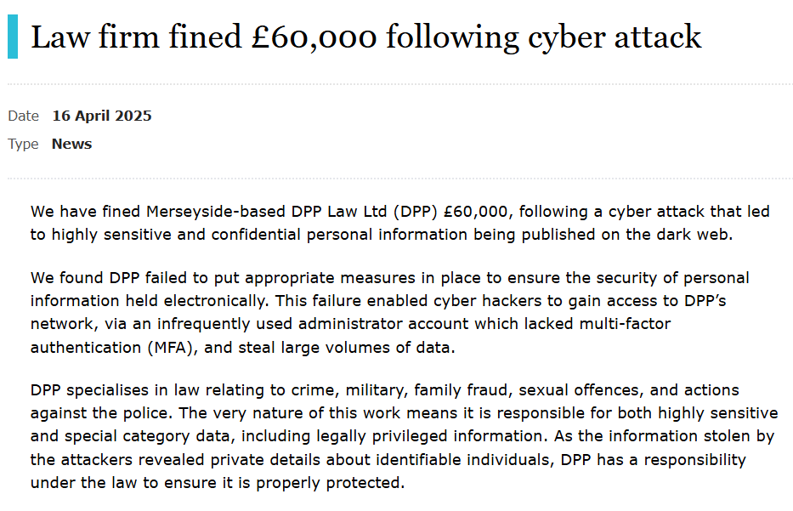
ICO Case Studies

Slide 17
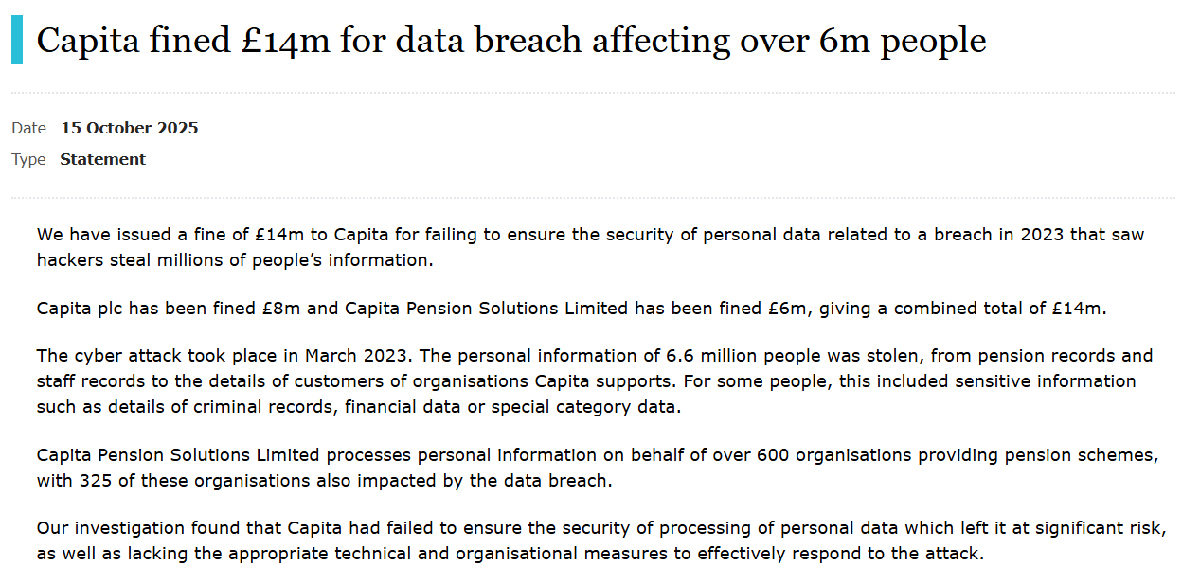
ICO Case Studies

Slide 18
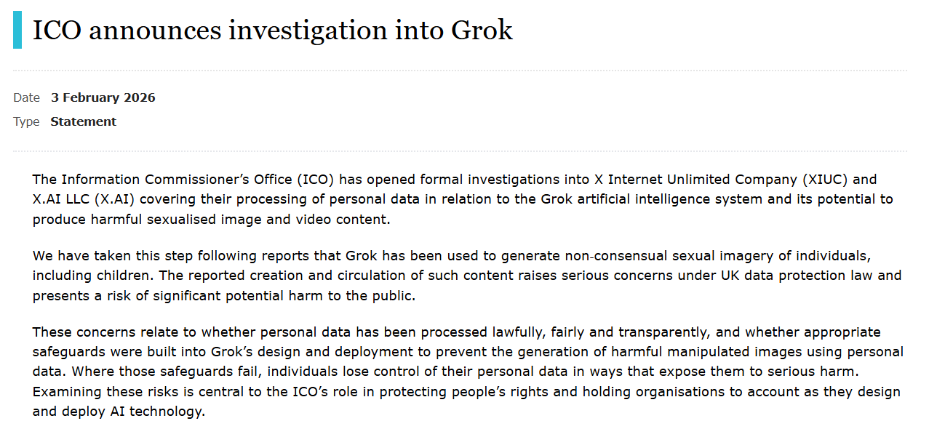
ICO Case Studies

Slide 19
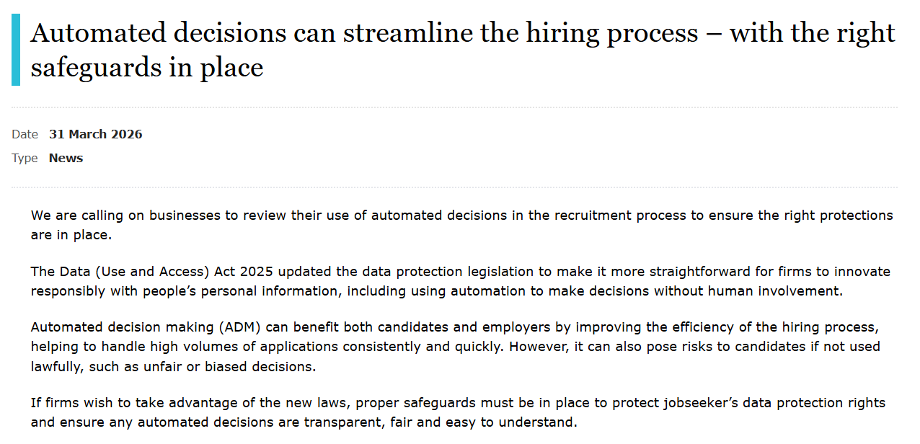
ICO Case Studies

Slide 20
Internal Governance
Data Protection Policy;
AI Policy or Guidelines;
Data Breach Response Plan;
Data Retention and Disposal Policy;
Incident Management Procedure;
Due Diligence Procedure;
Training and Awareness Policy;
DPIA’s; and
Legitimate Interest Assessments (“LIAs”).

Slide 21
AI Governance
AI Policy or Guidelines;
  Procurement
  Transparency
  UK Sector specific regulation Vs EU AI Act
  Risk Identification: AI DPIA
  Regular review and updating as technology evolves
Staff AI Training

Slide 22
Summary
Compliance risk – failing to meet legal and regulatory obligations.
Action Point: ensure requirements are identified, documented and embedded in supplier controls.
Security risk – exposure of data and systems to cyber threats or misuse.
Action Point: assess protections and agree minimum security standards and monitoring.
Supplier risk – poor oversight or reliance on third parties.
Action Point: carry out due diligence and establish ongoing performance reviews.
Contract risk – unclear or incomplete agreements creating uncertainty.
Action Point: review and strengthen contract terms, responsibilities, and accountability.
Dependency risk – over-reliance on suppliers without clear exit or continuity options.
Action Point: define exit strategies, data portability, and contingency planning early.

Slide 23
Questions?

Slide 24
AI, GDPR, IT and Supplier Risks: Where Things Go Wrong (and How to Fix Them)
Presented by Peter Wright, Solicitor and Managing Director of Digital Law for The RiskBites ® Club
​​
For more information contact: peter.wright@digitallawuk.com
Disclaimer
.
Please note that the information contained in this presentation is provided for general informational purposes only. It does not constitute any form of legal or other professional advice, and you should not use it as a substitute for advice tailored to your specific circumstances.
We disclaim all and any liability for any actions you take (or omit to take) in reliance upon the contents of this presentation.
Our contact details are below should you wish to contact us for professional advice.
Risk@kareneckstein.co.uk
07973627039

