Slide 1
How to become a Superhero​
Developing Resilience in times of crisis
Presented by Karen Eckstein for The RiskBites ® Club​​
08 July 2025

Slide 2


Tip 1-T4- Take a Step

Slide 3


Tip 2 –Look back in praise

Slide 4
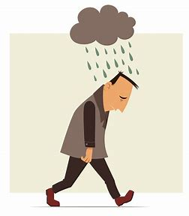

Tip 3- Radiators and Drainers

Slide 5
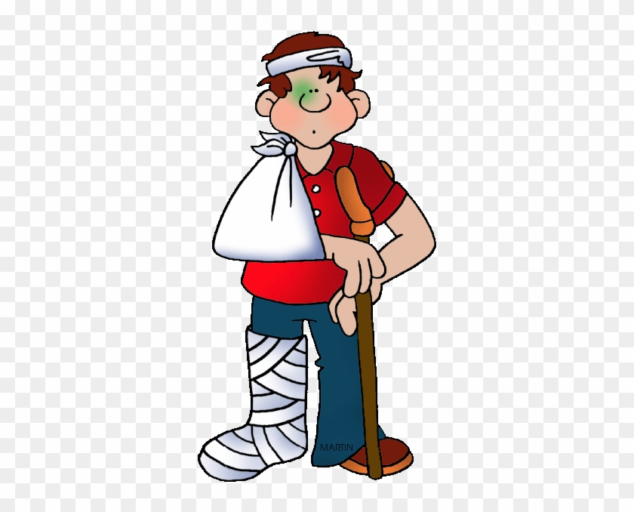

Tip 4- Victim or Survivor? You choose!

Slide 6
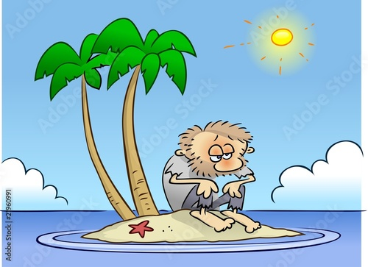
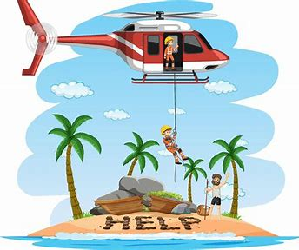
Tip 5- No One is an Island

Slide 7

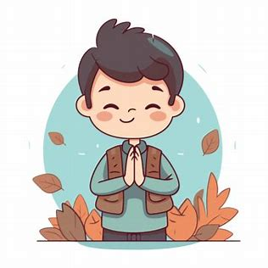

Tip 6- Practice Gratitude

Slide 8

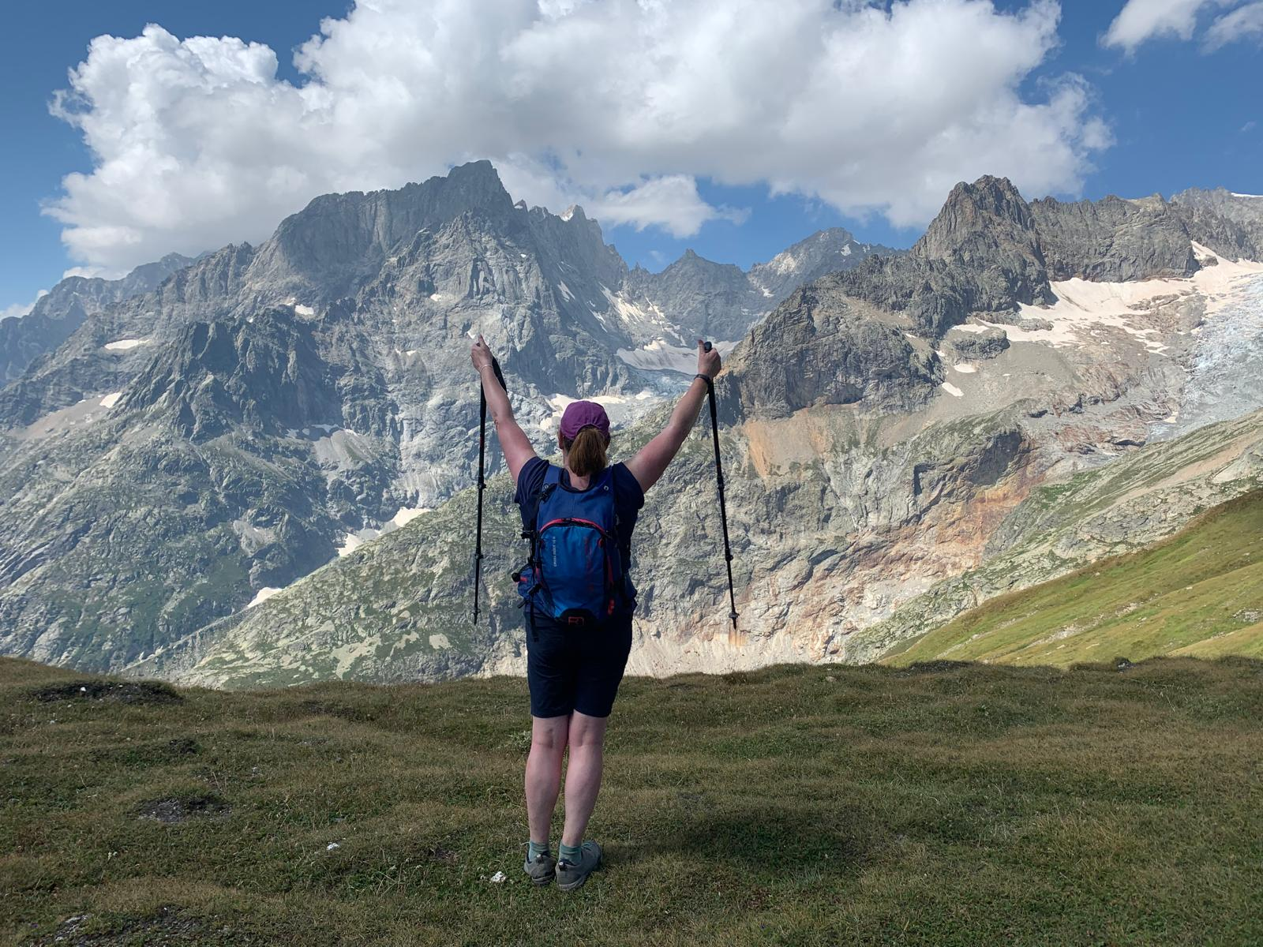
Tip 7- The Reason Why

Slide 9
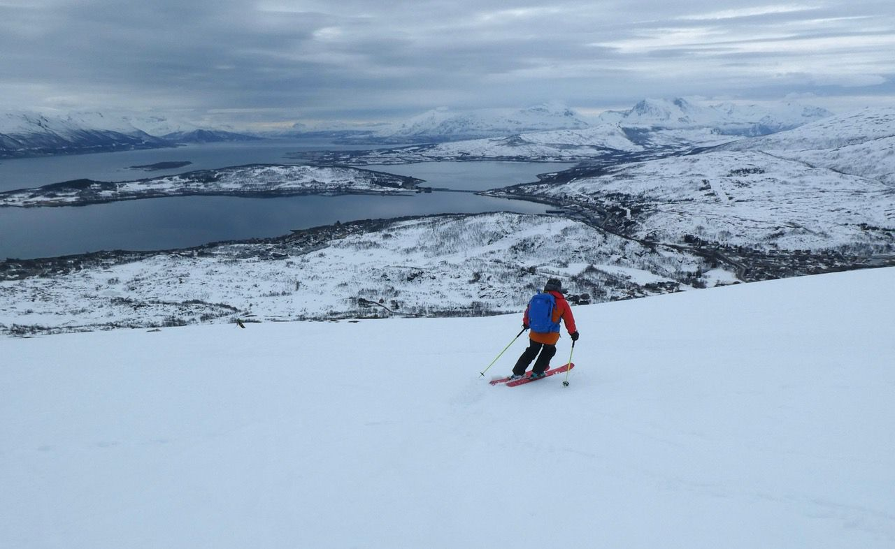
The reason why part 2

Slide 10


Tip 8- Accountability and Kindness

Slide 11
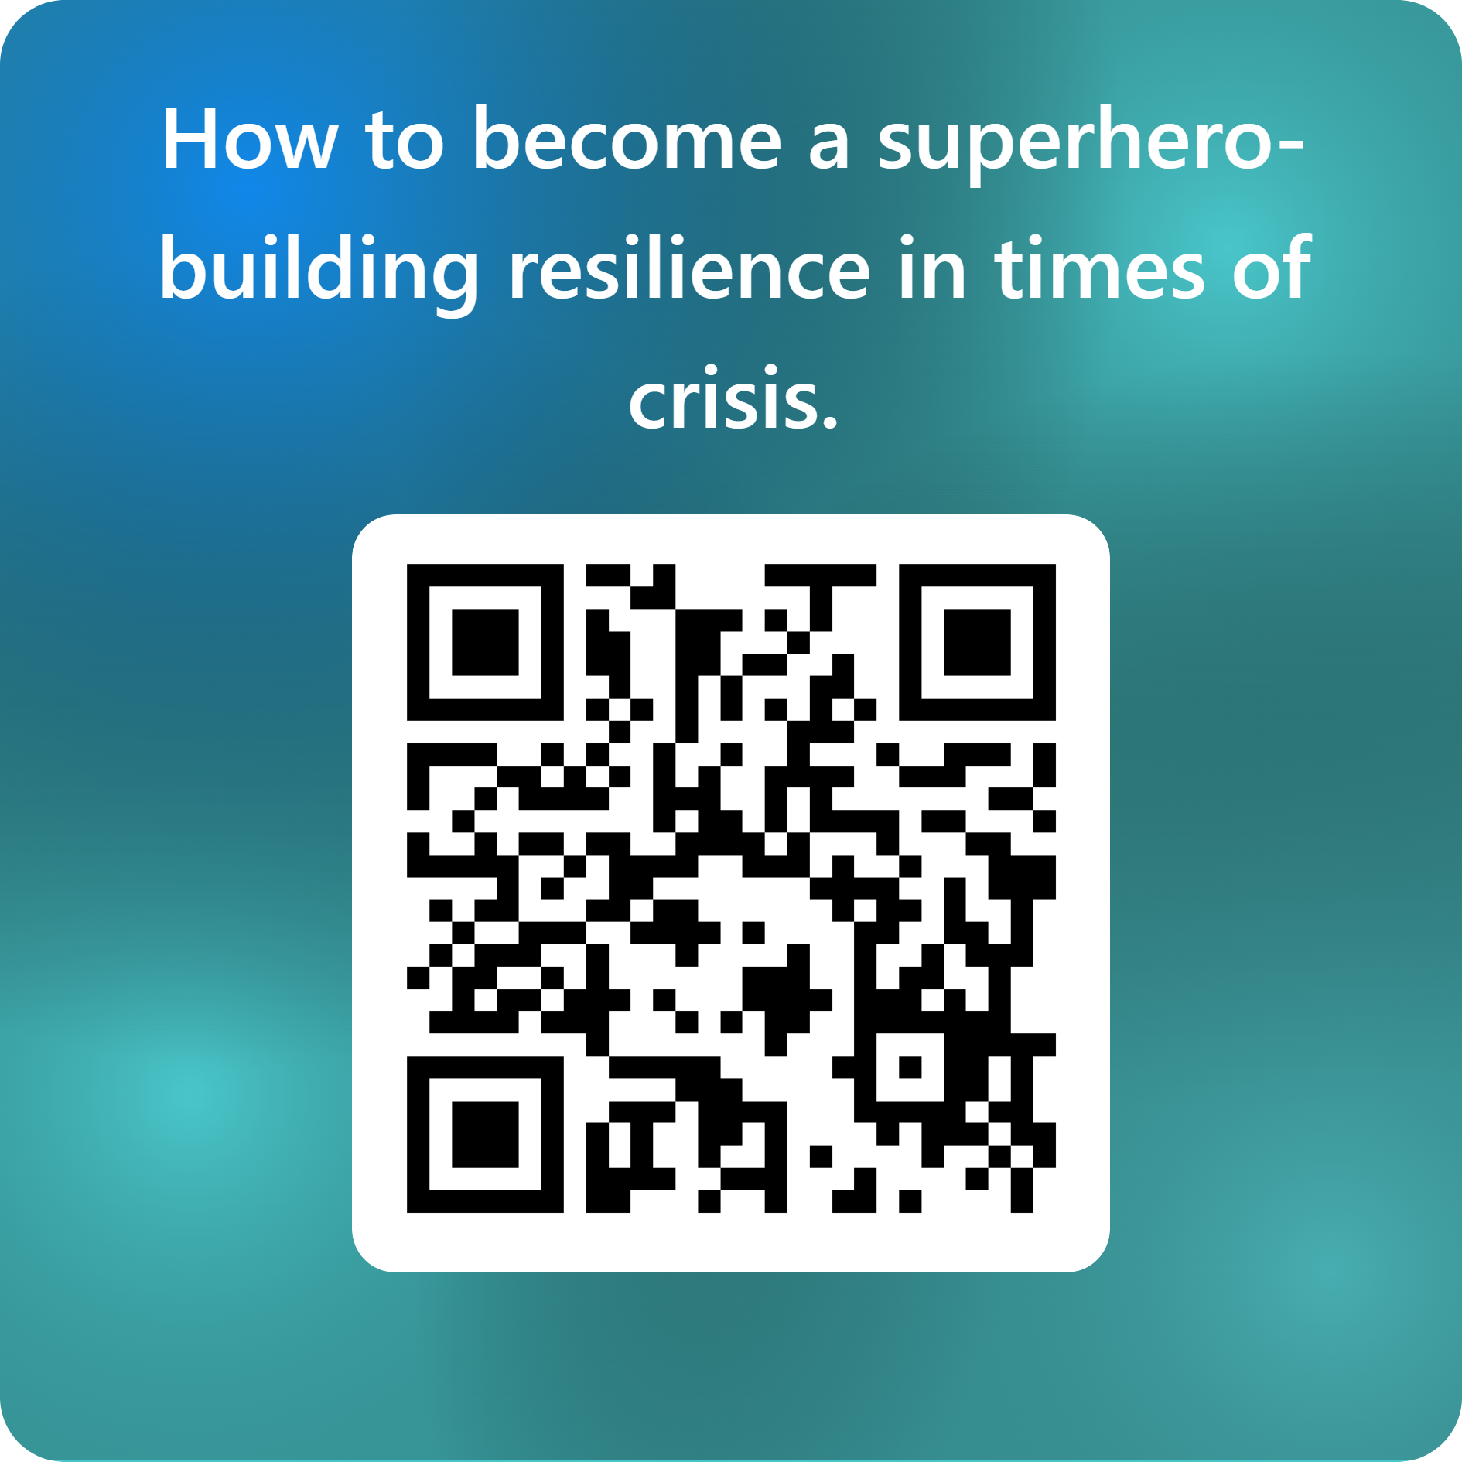
Your Feedback Matters
Thank you so much for attending today’s RiskBites® session.
I would be really grateful if you could take a moment to complete my short feedback form – your comments help me improve and shape future presentations.
Just scan the QR code to share your thoughts.
Thank you again for coming – I really do appreciate your time and your feedback!
Karen

Slide 12
How to become a Superhero​
Developing Resilience in times of crisis
Presented by Karen Eckstein for The RiskBites ® Club​​
Disclaimer
.
Please note that the information contained in this presentation is provided for general informational purposes only. It does not constitute any form of legal or other professional advice, and you should not use it as a substitute for advice tailored to your specific circumstances.
We disclaim all and any liability for any actions you take (or omit to take) in reliance upon the contents of this presentation.
Our contact details are below should you wish to contact us for professional advice.
Risk@kareneckstein.co.uk
07973627039

