Slide 1
Hidden Risk, Missed Revenue: The Referral Problem (and Opportunity) You Can’t Ignore
Presented by Steve Raynard of RQ for The RiskBites ® Club​​
13 May 2025

Slide 2


Slide 3
Private & Confidential
Referrals from clients and fellow professionals are your biggest growth opportunity
Inbound referrals
Outbound referrals
High-converting leads
Scalable channel
Retain and delight clients
Increase your share of wallet

Slide 4

Private & Confidential
But most firms still rely on spreadsheets to track and manage referrals…

Slide 5
Private & Confidential
… resulting in a data black hole
We’ve yet to meet a firm that knows:
How many referrals are going in, out, or within the firm
Who are they going to – and why
How satisfied the referred clients are
What income’s been generated and how much is due
And that’s a problem.

Slide 6
Private & Confidential
Private & Confidential
Costing your firm revenue and creating a hidden risk
Risk
Even if no money changes hands, referrals are regulated.
Get it wrong, and you risk fines, scrutiny, and reputational damage.
Missed opportunity
Untracked referrals mean lost income and missed chances to delight clients.
“What gets measured, gets managed.”
– Peter Drucker

Slide 7
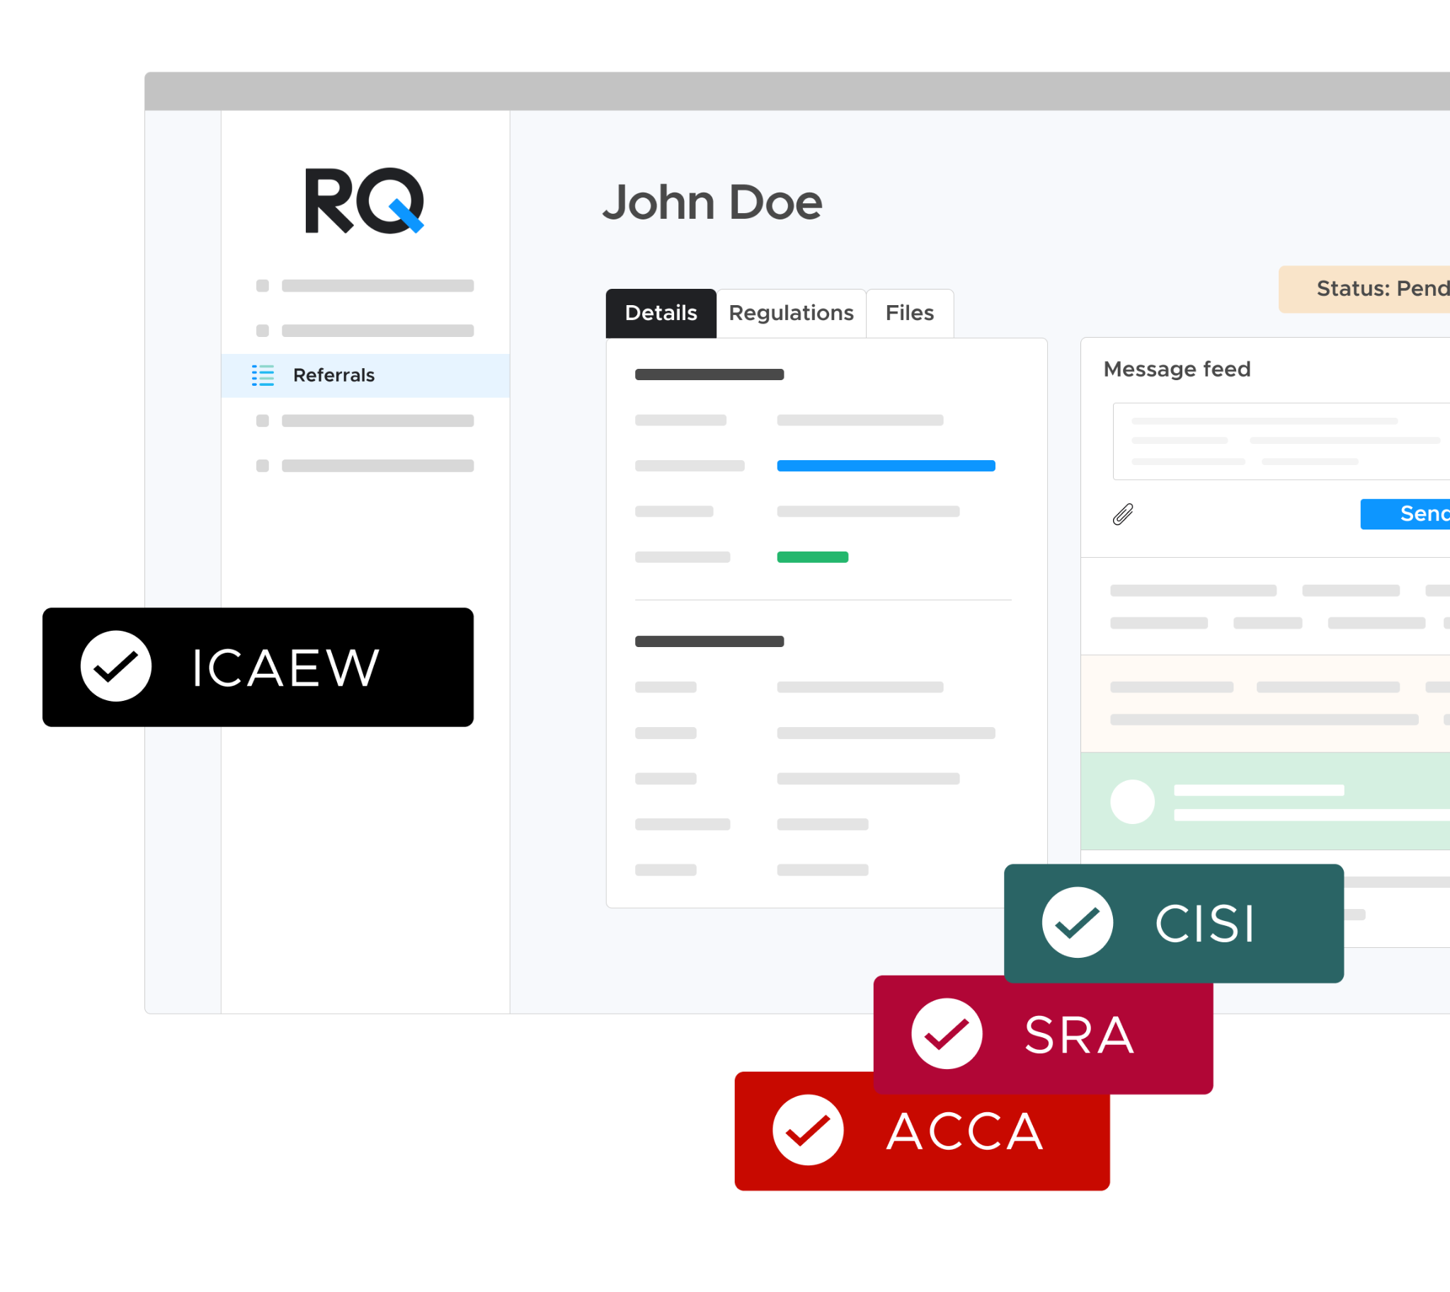
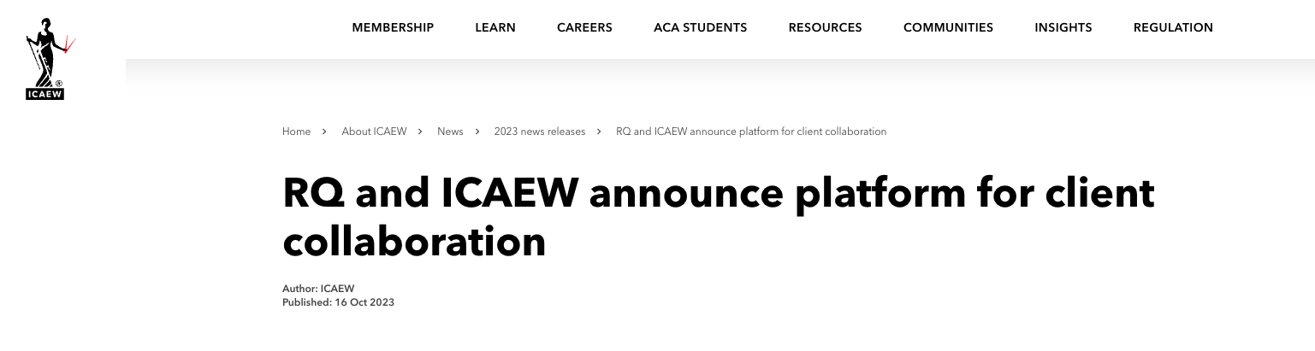
Private & Confidential
RQ has been
built in collaboration
with the regulator
RQ and ICAEW announce platform for client collaboration
Author: ICAEW, Published: 16 October 2023

Slide 8
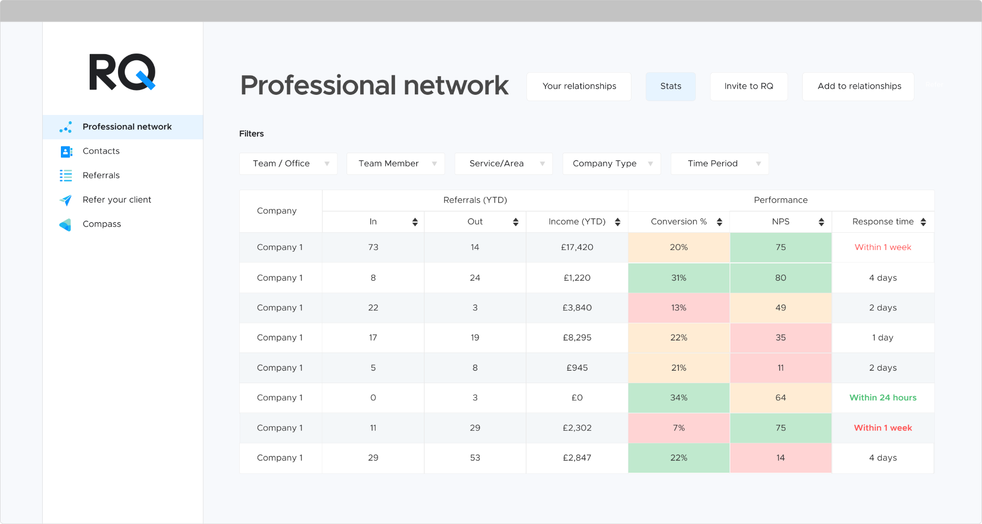
Automate
Instant visibility of your company’s referral activity
Happier clients - Introduce clients for all the services they need
Untracked referrals mean lost income and missed chances to delight clients.
Increase revenue
Reducing regulatory risk

Slide 9
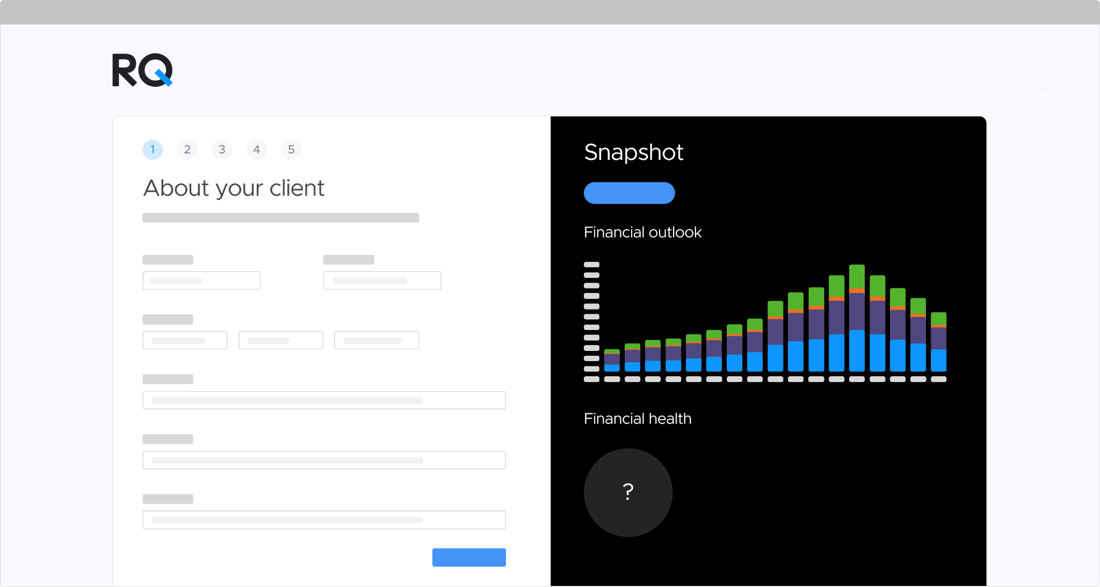
Generate
Organically increase your revenue
Self-generating financial health report
Investors require organic growth -
Compass delivers it
Proactively finds referrals to send internally or externally
Monthly overview of upcoming client needs

Slide 10
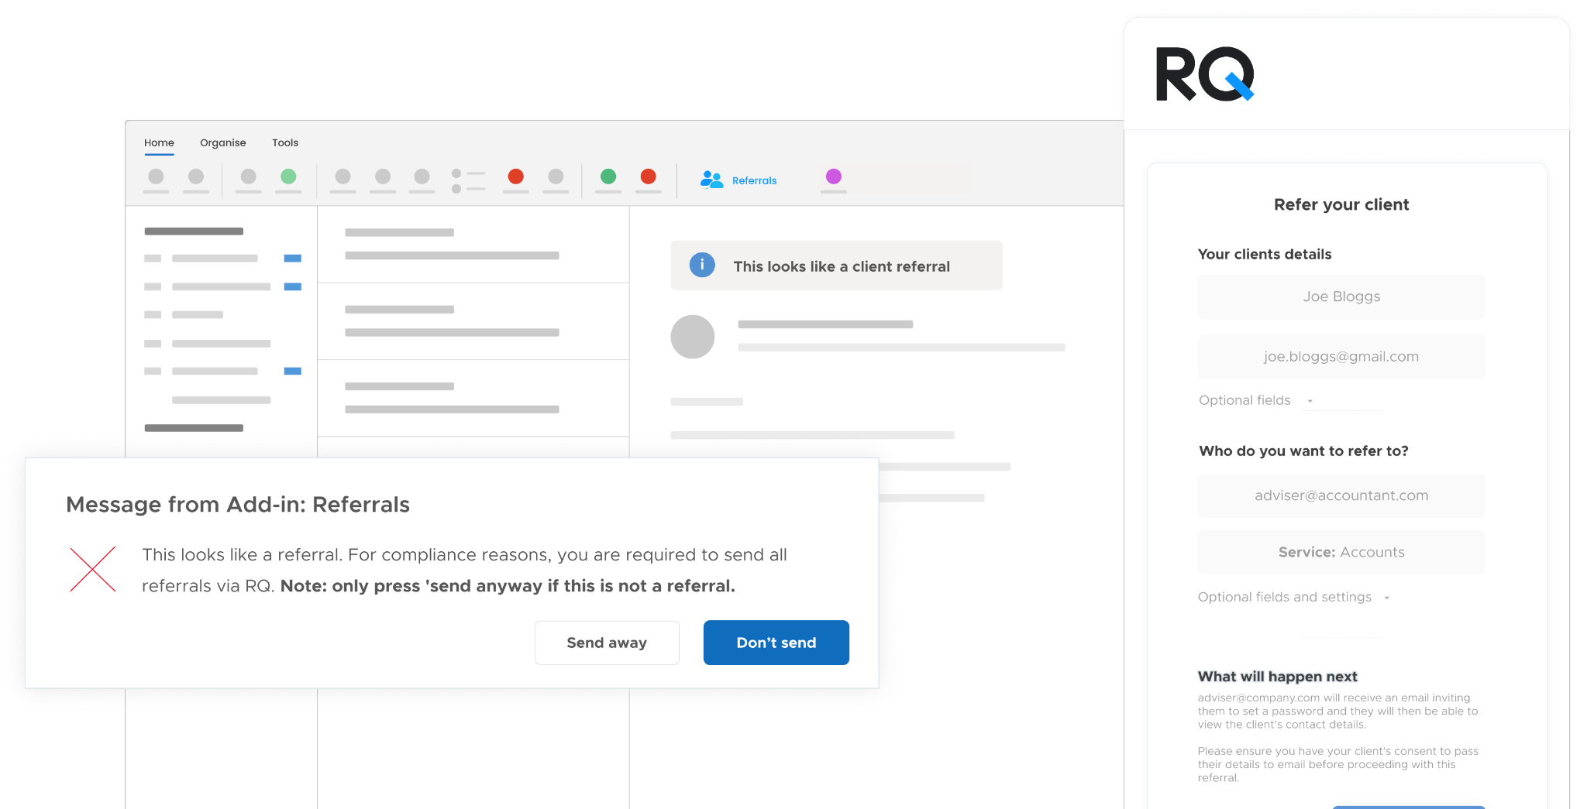
No lengthy implementation or training
Activate RQ within your team’s Outlook and see value instantly

Slide 11






Trusted by 600+ professional services firms
You’re in good company. Join hundreds of forward-thinking firms already using RQ, including:

Slide 12
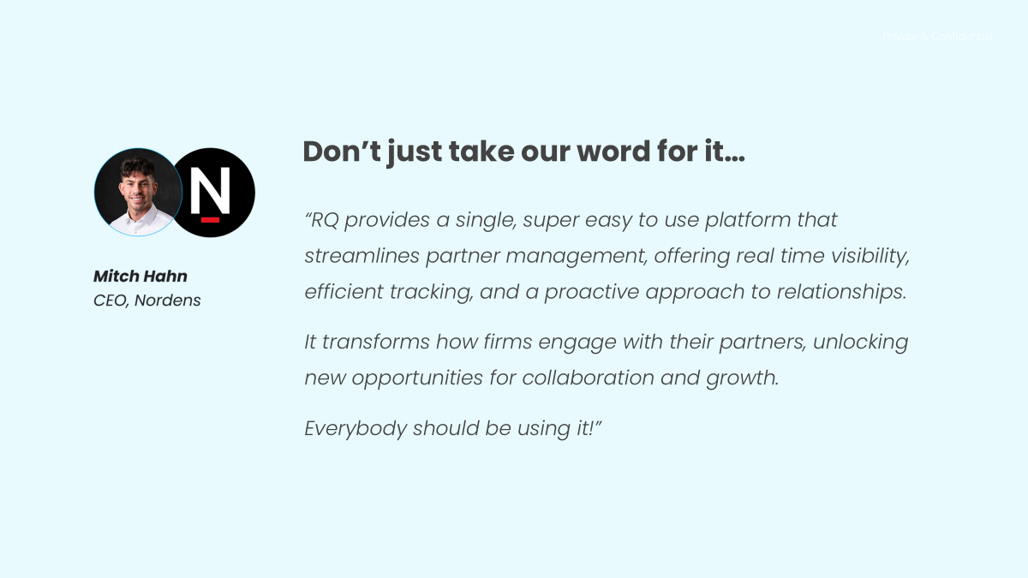
Book in a meeting today
Schedule

Slide 13

Schedule

Slide 14
Hidden Risk, Missed Revenue: The Referral Problem (and Opportunity) You Can’t Ignore
Presented by Steve Reynard of RQ for The RiskBites ® Club​​
For more information contact: steve@rq.app
Or schedule a meeting: https://meetings-eu1.hubspot.com/steve-reynard/rq-demo
Disclaimer
.
Please note that the information contained in this presentation is provided for general informational purposes only. It does not constitute any form of legal or other professional advice, and you should not use it as a substitute for advice tailored to your specific circumstances.
We disclaim all and any liability for any actions you take (or omit to take) in reliance upon the contents of this presentation.
Our contact details are below should you wish to contact us for professional advice.
Risk@kareneckstein.co.uk
07973627039

