Slide 1
Navigating the risks of client onboarding with effective CDD
Presented by Colin Tansley for The RiskBites ® Club
9 April 2024

Slide 2
About me
Former Senior Police Officer
Over 40 years of experience
Last 14 years specialising in Due Diligence, training and investigation
8 years living/working on the Isle of Man
Now Yorkshire based

Slide 3
Where we are heading today
Why Due Diligence is necessary
Types of Due Diligence
Case studies
Where IRIS and EDDIE fit in
Questions and answers

Slide 4
Why?
It’s the law
Preventing financial crime
Failure to do so will damage your reputation
Loss of licence
Regulatory action

Slide 5
Terminology
Know Your Client/Customer – KYC
Client Due Diligence/Customer Due Diligence – CDD
Enhanced Due Diligence - EDD

Slide 6
Or…
KYC
CDD
EDD

Slide 7
KYC
Identity check
Tends to be in the form of a passport/driving licence, utility bill and forms
Sometimes, address checks

Slide 8
CDD
As per KYC, plus, at least the following
Adverse media
Beneficial ownership
Jurisdictional risks
Sanctions
PEP checks
Source of wealth/funds
AND a risk assessment!

Slide 9
EDD
As per CDD, but a more focused understanding of any identified (or unidentified) risks, for example,
Business network
Certain commodities – for example, oil, arms, precious metals, tobacco products
Geo-political issues
Non face to face business
Political connections
Technology such as crypto currency

Slide 10
Challenges
Too much information!
GIGO
Googling it
Clicking, not searching
Languages
Knowing when to stop
Auditable records

Slide 11
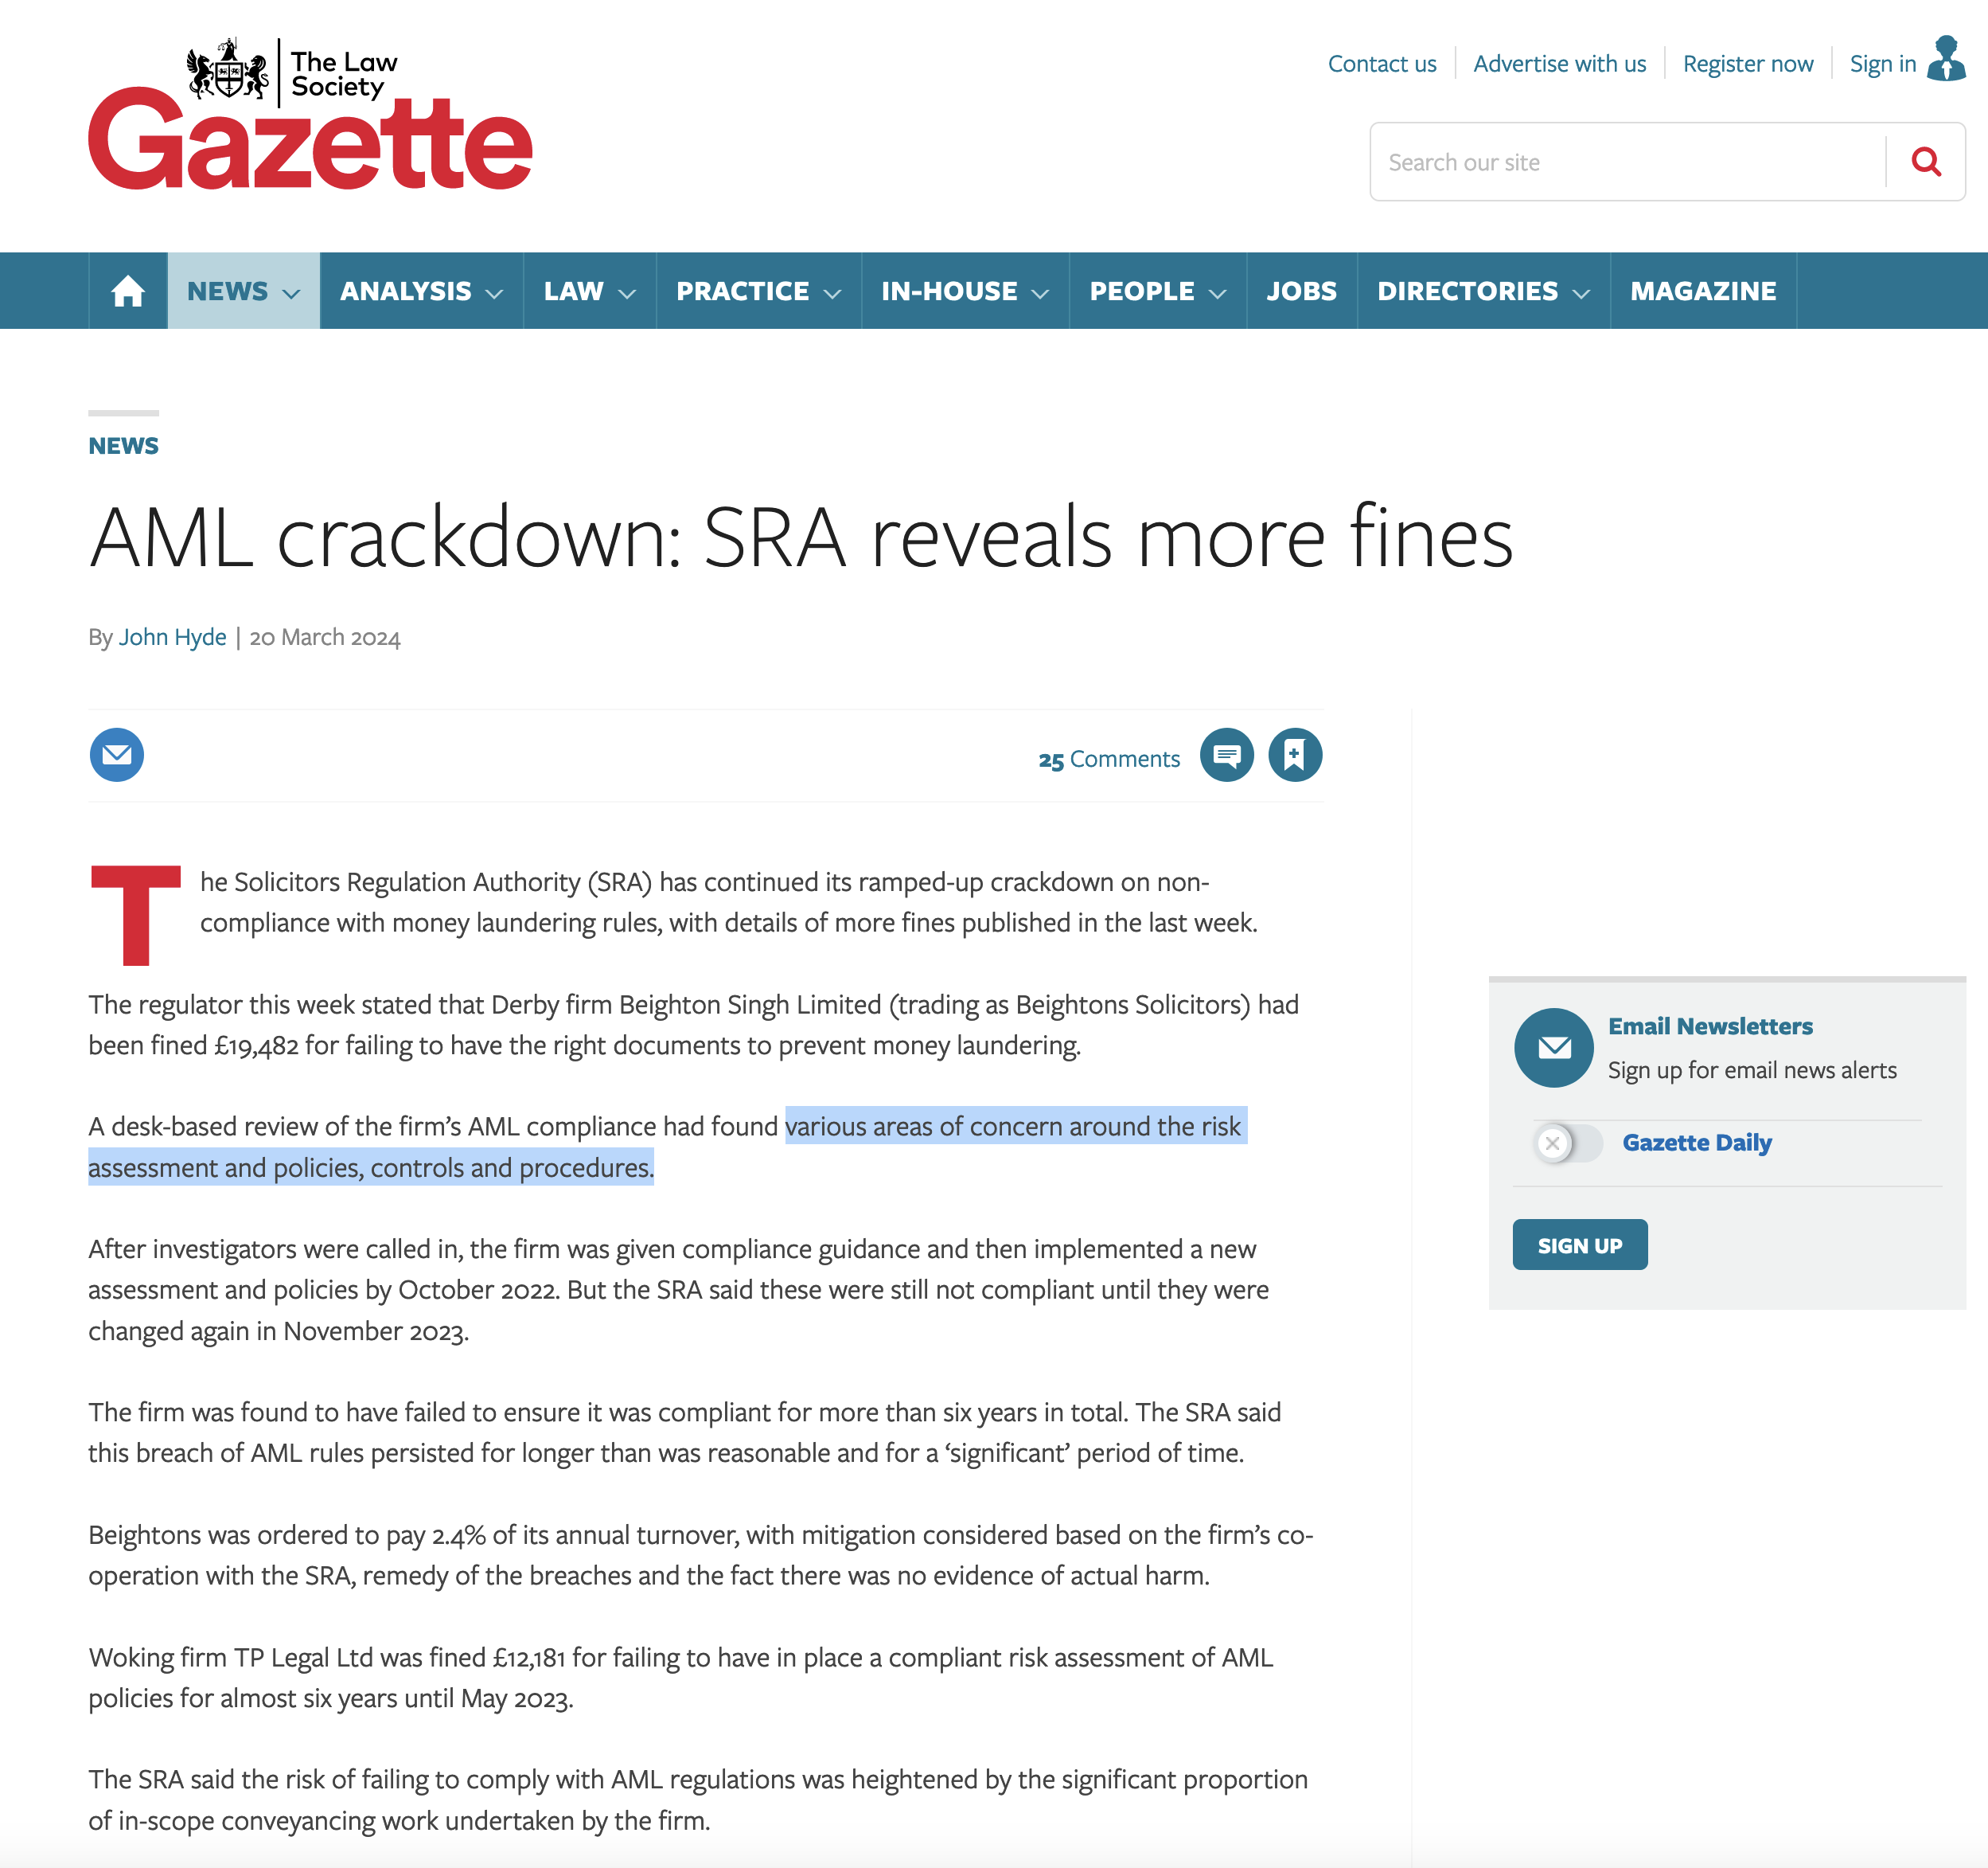
Notes:
From the beginning of October to the start of March, the regulator issued or agreed 19 fines for this misconduct, of which 10 had been for at least £10,000.

Slide 12
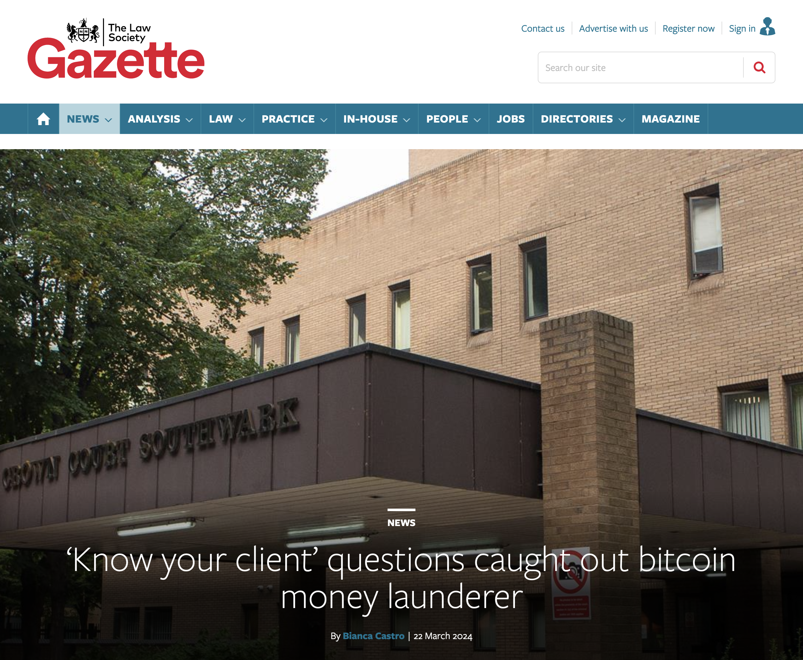
Notes:
Jian Wen, 42, a former Chinese takeaway worker, was convicted at Southwark Crown Court (pictured) for her part in converting ‘significant amounts’ of bitcoin into cash and other assets on behalf of another.
Police seized bitcoin wallets from Wen with an initial estimated value in excess of £2bn.
Between autumn 2017 and late 2018, Wen attempted to purchase properties in London valued at £4.5m, £23.5m and £12.5m. Difficulties in converting sufficient bitcoin into sterling and ‘know your customer’ questions asked of her under anti-money laundering regulations hampered the purchases, the Crown Prosecution Service said.
When she was challenged about the source of the proposed funding, Wen claimed it came from legitimate activities including bitcoin mining. Her claims were not accepted by those she instructed to assist with the sale.
However in October and November 2019, she purchased two properties in Dubai for a total of more than £500,000. She also brought jewellery worth tens of thousands of pounds and travelled ‘extensively’.
Wen said she had been gifted £15m worth of Bitcoin by her employer. She denied knowing any of the bitcoin was derived from criminality.

Slide 13
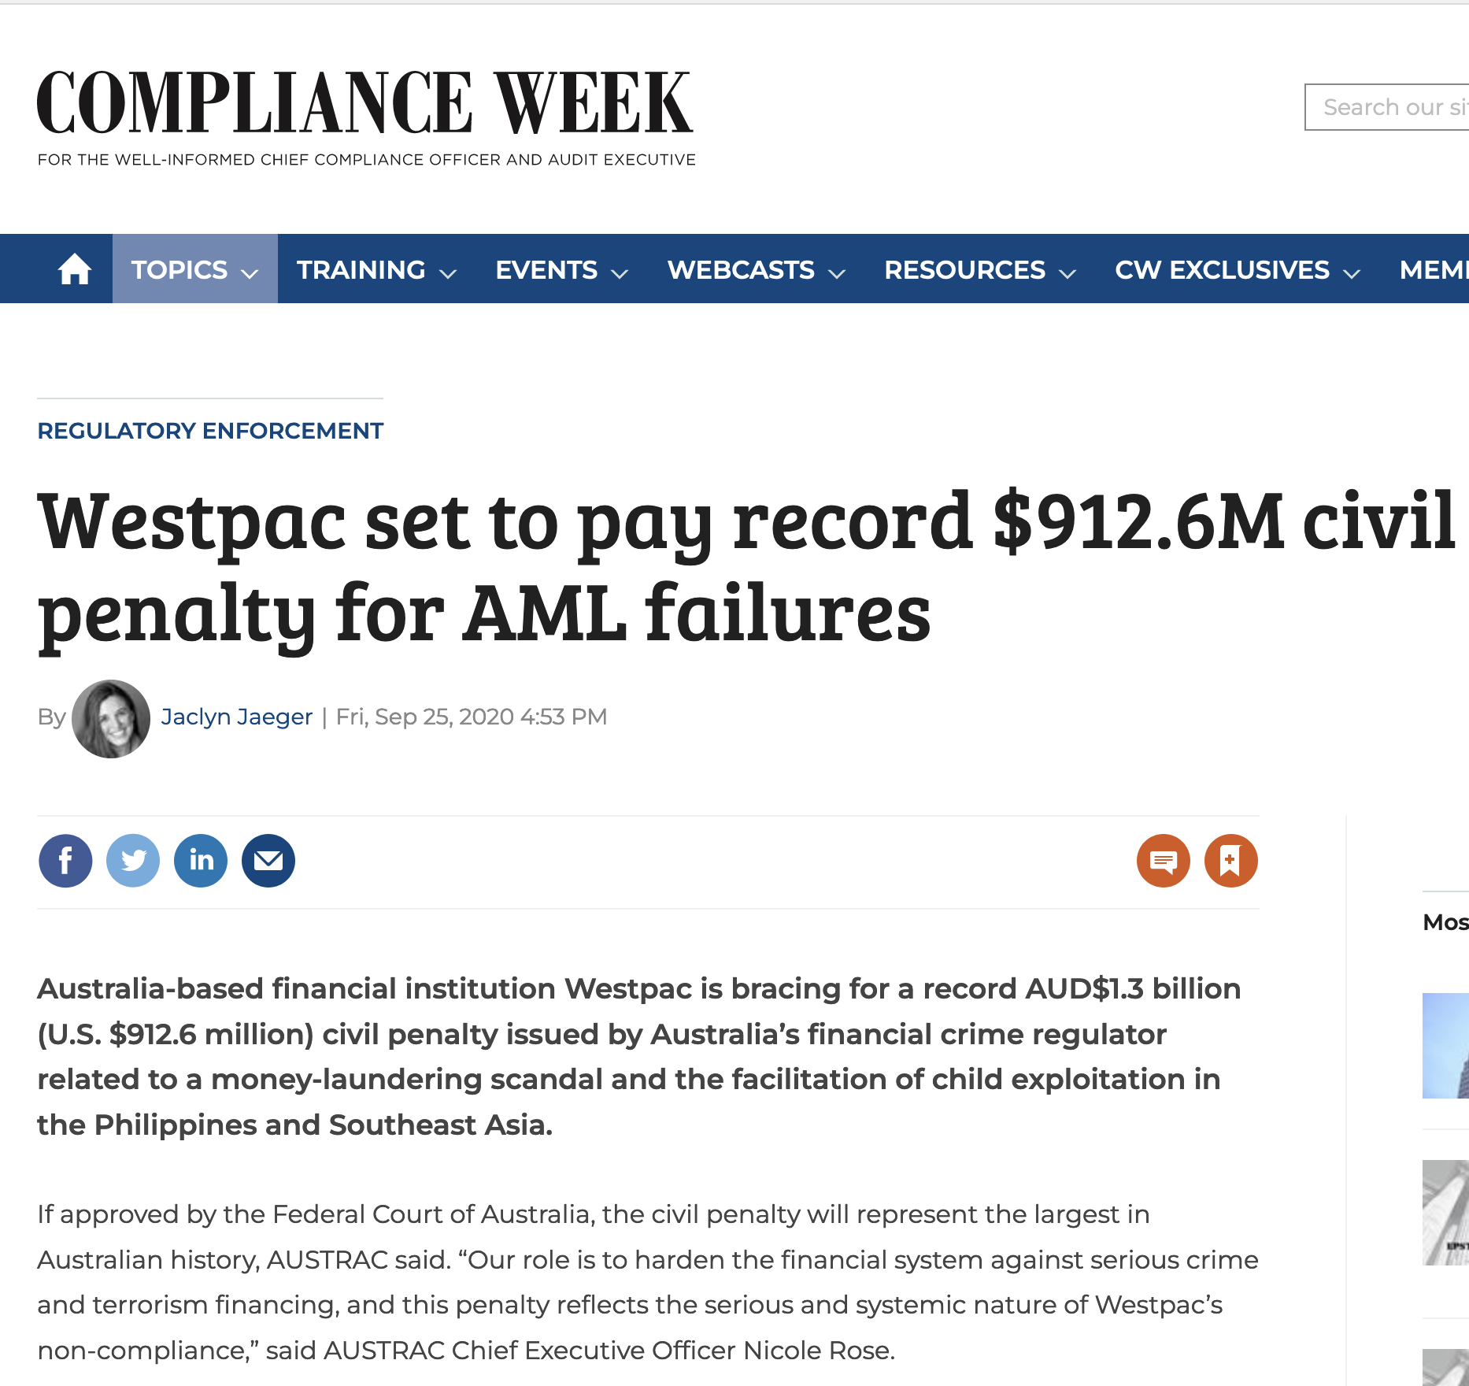
Notes:
Child exploitation links

Slide 14
IRIS/EDDIE Demo
Notes:
To learn more visit the following link: https://intelect-group.com/eddie/

Slide 15
Navigating the risks of client onboarding with effective CDD – Any Questions?
Disclaimer . Please note that the information contained in this presentation is provided for general informational purposes only. It does not constitute any form of legal or other professional advice, and you should not use it as a substitute for advice tailored to your specific circumstances.
We disclaim all and any liability for any actions you take (or omit to take) in reliance upon the contents of this presentation.
Our contact details are below should you wish us to contact us for professional advice.
Risk@kareneckstein.co.uk-07973627039
Karen Eckstein
LLB, CTA, Cert IRM

