Slide 1


Managing Fraud Risks – What Keeps You Awake at Night?
A Discussion for The RiskBites Club®
Presented by Vikshay Vijai of Allianz and Robert Brooker of PFK GM

Slide 2
What is fraud? (1)
Fraud by False Representation
  Lying about something, using any means (words or actions)
Fraud by Failing to Disclose
  Not saying something when you have a legal duty to do so
Fraud by Abuse of a Position of Trust
  Abusing a position where there is an expectation to safeguard the financial interests of another person or organisation

Slide 3
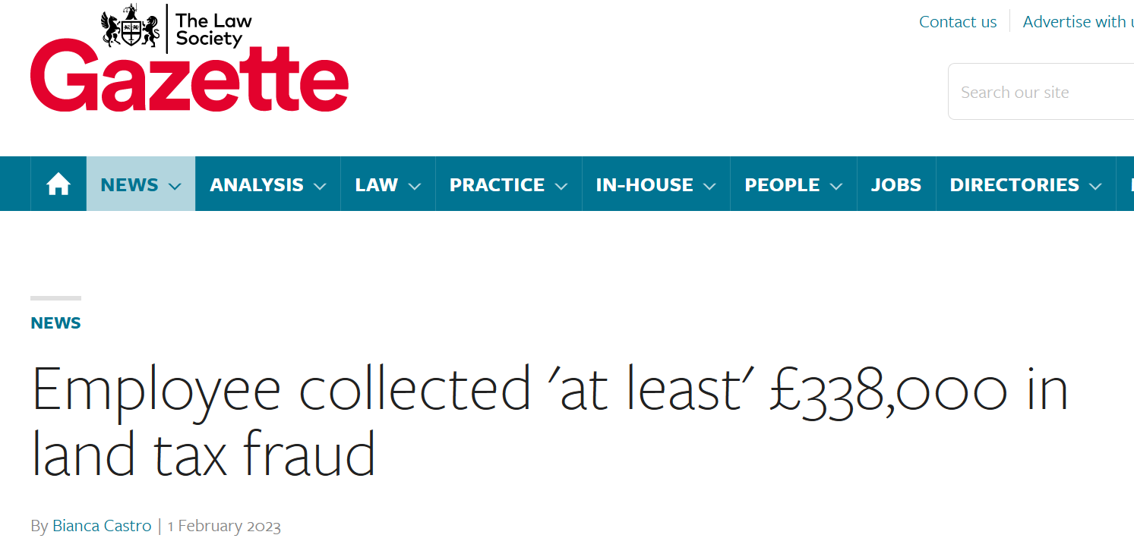
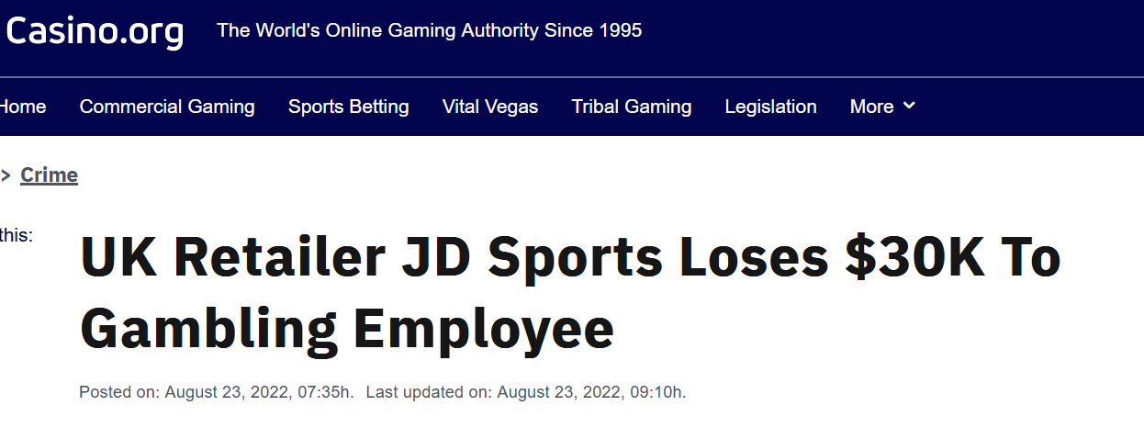
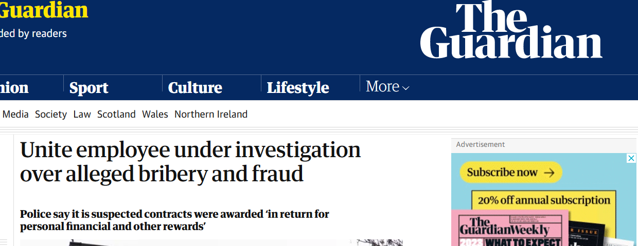
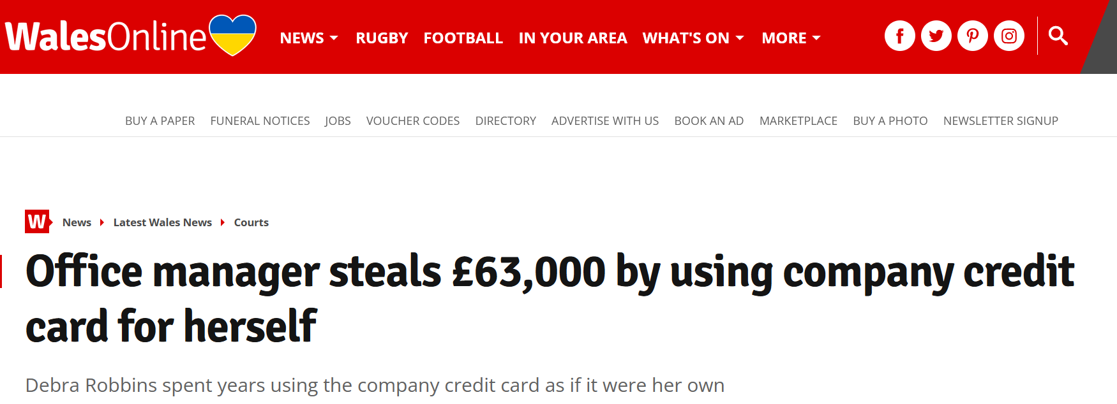
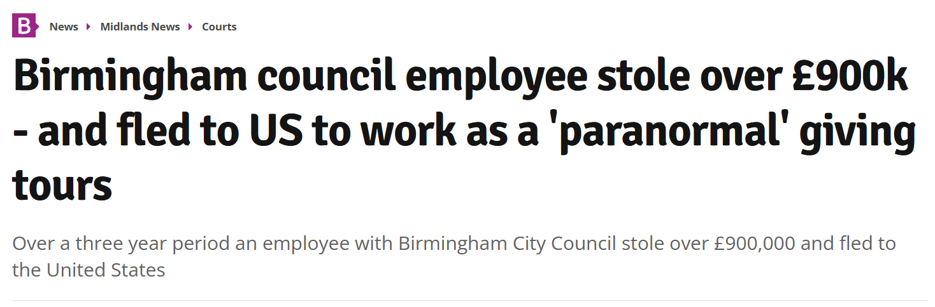
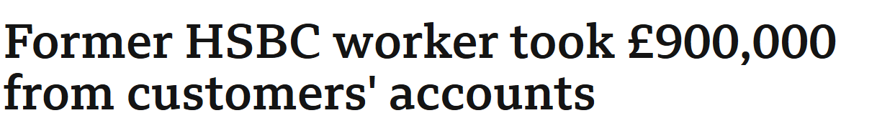
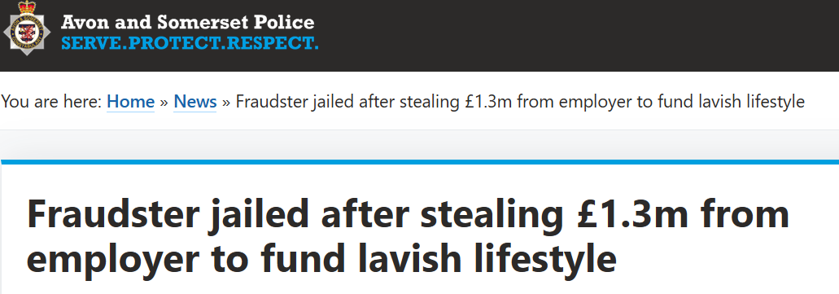
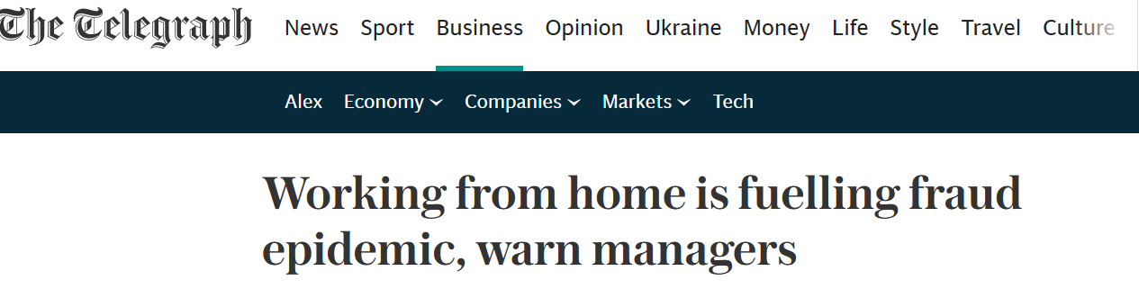
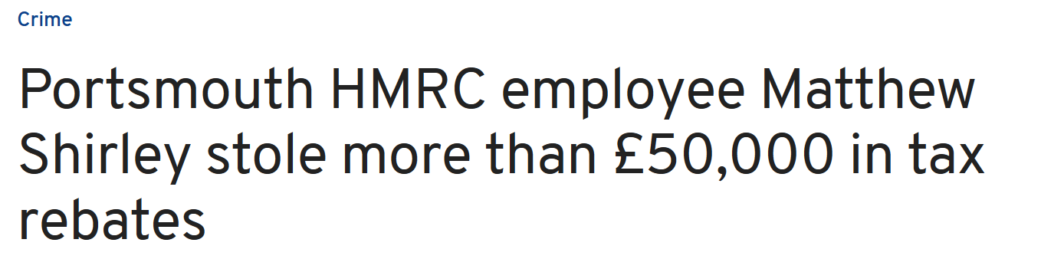
What is fraud? (2)
8 out of 10 mid-sized businesses were impacted by fraud in 2021
Notes:
https://www.bdo.co.uk/en-gb/news/2022/more-than-a-third-of-uk-firms-report-fraud-increase-in-2021

Slide 4
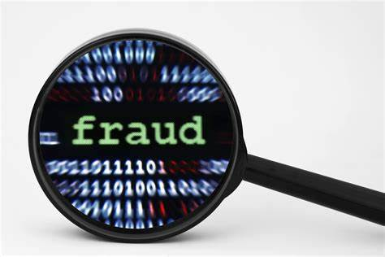
What is the legal bit?
The Fraud Act 2006. … “a deliberate action to secure unfair or unlawful gain, or to deprive a victim of a legal right”.
The focus is on an individual’s ‘dishonest behaviour’ and their intent to make a gain or cause a loss.
This act splits fraud into three main areas:
  Fraud by false representation
  Fraud by failing to disclose
  Fraud by abuse of a position of trust

Slide 5
Did you know?
420,000 white-collar crimes were recorded in the UK in 2021 (+36%). Source: Action Fraud
2.5 billion pounds were lost by UK residents and businesses due to fraud and crime in 2021, with 62,976 reports made by British businesses. Source: Payback / National Fraud Intelligence Bureau
50% of UK businesses have been victims of fraud in the past two years. Source: PwC
Only 15% of fraud is uncovered during internal audits - a lower amount than through whistleblowing (16%). Source: PwC
57% of all white-collar crime is perpetrated by insiders. In 31% of cases they are acting alone. Source: PwC, Study White-collar crime 2022
£72,000 is lost by UK businesses in over 51% of fraud cases. Source: PwC
£37,741 is the average cost of dealing with just one fraud case worth £72,000. Source: UK Finance, uncovering the real cost of fraud
Notes:
“The total value of reported alleged fraud cases £100k or above heard in UK courts increased by 151% from £444.7m in 2021 to £1.12bn in 2022, according to data released in KPMG UK’s latest Fraud Barometer. Volumes fell by 27% (219 in 2022)”

Slide 6
The most common types of fraud
Fake CEO
Assumption of identity
Instructions (e.g. urgent transactions)
Payment Diversion
Fraudster impersonates a business partner or supplier
Fake Identity
Person pretending to be a customer provides changed delivery address
Employee Fraud
Insistency on secrecy
Affected accounts emptied before fraud identified
Forged messages/changed bank details
Payment for goods or services to the wrong bank account
Delivery
No payment
Monetary theft – cash or fake vendors/invoices
Physical theft – taking inventory
Compensation fraud – paying benefits for fake situations

Slide 7

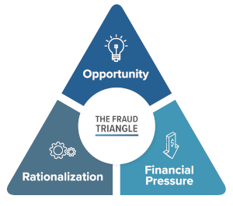
What leads people to commit fraud?
Opportunity:
Remote working
Gaps in internal control
Lack of monitoring
Unclear processes
Rationalisation:
Increased economic uncertainty
“I deserve a pay rise” “I’ll pay it back”
Financial Pressure:
Financial hardship
Addiction/ lifestyle
Notes:
The ongoing impacts of the pandemic and associated lockdowns have exacerbated the risk of being targeted by fraudsters, with many citing the shift to remote working as a driving factor. Of those surveyed, approximately nine in ten (89%) business owners and directors think their company is more exposed to fraud since 2020, while almost a quarter (23%) believe their exposure has “significantly” increased. The overwhelming majority (89%) said fraud risks at their business have increased as a direct result of home working.
Most bizarre motives: Designer clothes, mallorcan villa, fine art, keeping a mistress happy, Keeping a spouse happy, luxury sport cars, plastic surgery
Most common motives: gambling, greed, financial pressures, status symbol/ showing off, fear of social decline

Slide 8
How do perpetrators get caught?
Internal processes > routine checks/audits > checks on anomalies
Whistleblowing > tip-offs from other employees > tip-offs from outsiders or collaborators
Pure chance > bad luck for the fraudster > good luck for the company
Confessions > guilty consciences > attempts to reduce penalties

Slide 9


Tone at the top, prescribes the manner in which an organisation behaves, as it defines senior leadership and the board of director’s governance and their vow to being honest, transparent and ethical.
Tone at the top was made popular due to numerous corporate accounting scandals such as Enron, WorldCom & Adelphia
The tone at the top sets a company’s culture and the behaviours of all follow accordingly, but only if there are consequences for those who fail to adhere.

Slide 10
Excessive trust
Myths?
Employees would not target their own company
Lack of “challenge”
People who work in accounts do not commit fraud
Not possible to put in place all the controls required to prevent fraud
Absence of oversight/ segregation of duties
Reluctance to recognise/treat fraud as fraud
Themes

Slide 11
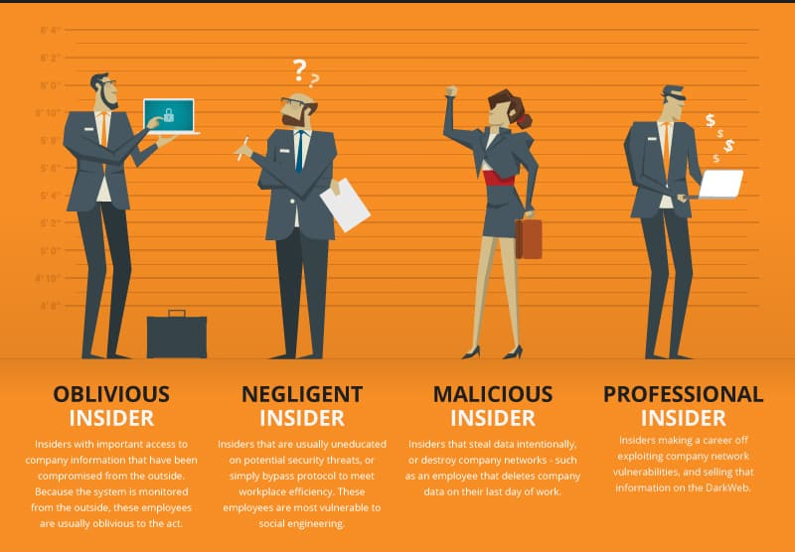

Slide 12


Slide 13
Business Fraud Insurance cover
Internal fraud / fraud by employees
  Fraud by employees (broad definition of employee).
  Identified and unidentified persons.
  Impacts on the insured company and on third-parties.
  Theft, fraud, embezzlement, damage to property, disclosure of trade secrets.
External fraud (named perils)
  Robbery, burglary and theft.
  Forged means of payments and payments made on the basis of a forged “order”.
  Certain types of Social Engineering, i.e. fraud committed by assuming a false identity, such as fake president fraud.
Costs and expenses linked to an event of loss
  We cover costs for the continuation of business operations up to 6 months after the occurrence of the event of loss.
  Costs and expenses linked to an event of loss (loss investigation, legal costs, contractual penalties….)
Notes:
Some exclusions:
When the company is aware that an employee has already committed a fraud.
Indirect losses: loss of profit, interest, fines, taxes, ransom, business interruption, trading losses, etc.
Board of Directors, CEO, authorized representative, Fraud caused by persons with >15% stake
Serial losses (or after discovery)
Fraud with violence
Inventory differences are excluded
Fat fingers (accidents)
Credit card fraud
Terrorism, war, fire, sanctions, etc.
Trade credit risks

Slide 14
Our Unique Selling Points
Market leader for Fraud/Fidelity insurance in Europe with a £150m book
A dedicated standalone fraud product – first to market
Retrospective cover for losses incurred before but discovered during the policy period
Provisional indemnity payment: customer may, in certain cases, get their 50% of their claim paid before it is settled in court
A dedicated team of claims experts
Simple and straightforward process to obtain a quote with our proposal form
36 month extended reporting period
Notes:
Profit from unlimited retroactive cover for losses incurred by your company before but discovered after the inception of cover.
As a rule of thumb, all your employees are automatically included in our cover.
New employees joining the company mid-year have no effect on the premium rate for that year.
Cover also applies in the case of unidentified Insured Persons
We cover you against losses due to disclosure of company and business secrets by Insured Persons.
We cover contractual penalties triggered by an event of loss.
We assume costs incurred to mitigate reputational damage caused to your company.
We assume legal costs and costs for the ascertainment of the loss incurred by you internally or externally up to a maximum of 50 % of the Limit of Indemnity.
You may receive a provisional indemnification of up to 50 % of the claim.
The Limit of Indemnity can be available up to three times.
The period for notifying losses after expiry of policy is 36 months, which can be extended to 48 or 60 months.

Slide 15
Any Questions?
.
Disclaimer
.
Please note that the information contained in this presentation is provided for general informational purposes only. It does not constitute any form of legal or other professional advice, and you should not use it as a substitute for advice tailored to your specific circumstances.
We disclaim all and any liability for any actions you take (or omit to take) in reliance upon the contents of this presentation.
Our contact details are below should you wish us to contact us for professional advice.
Risk@kareneckstein.co.uk
07973627039
Managing Fraud Risks – What Keeps You Awake at Night? Presented by Vikshay Vijai of Allianz and Robert Brooker of PFK GM
.
Vikshay Vijai
07815 678801
Vikshay.Vijai@allianz-trade.com
Robert Brooker
07917 001182
rbrooker@pkf-l.com

